Slide 1


Department of ECE
College of Engineering Guindy, Anna University, Chennai
EC5030– Project Review 1
Presentation for the First Review
14th October , 2025.
DESIGN AND VERIFICATION OF UART COMMUNICATION PROTOCOL USING SYSTEM VERILOG
Presented by:
Umesh Kanna. K. B (2022105010)
Rubesh K (2022105702)
Jaganath B (2022105522)
B.E - ECE (IVth year)
Under the Guidance of:
Dr. S. R. Sriram
Associate Professor
Department of ECE
CEG Campus, Anna University

Slide 2

Table of Contents
Introduction
Advantages and Disadvantages
Literature Review
Inference from Literature review
Block Diagram
Existing Techniques
Work done
Conclusion
References

Slide 3
Introduction
UART - Universal Asynchronous Receiver Transmitter
Why it’s called “Universal”?
Because its parameters - speed, data size and so on- are not fixed, and can be configured.
It is used for asynchronous serial communication.
Baud Rate is a measure of the speed of data transfer, expressed as symbol per sec/bits per sec.
Bit rate = No. of bits transferred per sec. Common baud rates: 9600, 4800, 19200, 38400 etc.

Slide 4
Introduction
Synchronisation in UART:
1.Start Bit - Every data frame begins with a start bit(logic 0)
2.Baud Rate Agreement - Both transmitter and receiver must be configured to the same baud rate
3.Stop Bits(s)- Marks the end of the data frame(logic 1)
4.Idle Line State - Line remains high(logic 1) when no data is being transmitted.
5.Parity Bit(optional) - Not for synchronization but helps detect transmission errors.

Slide 5
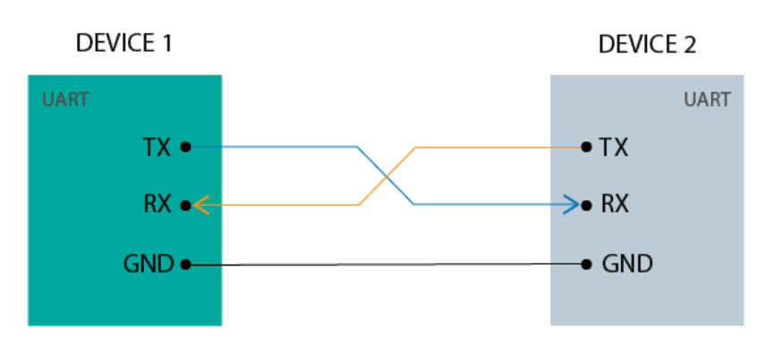
Introduction
UART Communication may be simplex, full duplex, or half duplex
Simplex: One direction only, transmitter to receiver
Half Duplex: Devices take turns transmitting and receiving
Full Duplex: Devices can send and receive at the same time.
Data format and transmission speed are configurable.
Communication goes through the two independent lines/wires.

Slide 6
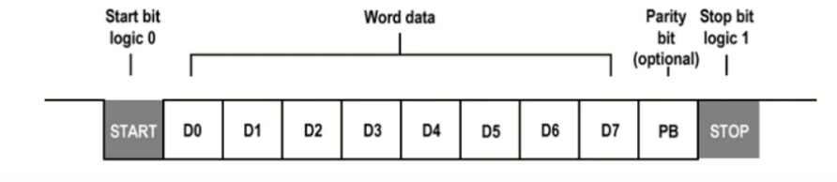
Introduction
Data Framing:
1.Start Bit: The UART transmission line is normally held at a high voltage level when idle (ie. its not transmitting data)
2.Data Frame: If one parity bit is used, then next 5-8 bits carry the “data bits”(information). Otherwise, data bits can be 5-9 bits.

Slide 7
Contd.
3. Parity:
It is an optional bit.
It is used to detect the wrong data packets, ie. error during transmission.
Two type of parity bit used: even parity, odd parity.
4. Stop bits:
To signal the end of the data packet, the sending UART drives the data transmission line from a low voltage to a high voltage.

Slide 8
Steps of UART Communication:
The transmitting UART receives data in parallel from the data bus. Adds start bit, parity bit, and stop bit to the data frame.
The entire packet is sent serially from the transmitting UART to the receiving UART.
The receiving UART samples the data line at the pre-configured baud rate.
The receiving UART discards the start bit, parity bit, and stop bit from the data frame.
The receiving UART converts the serial data into parallel and transfers it to the data bus on the receiving end

Slide 9
Advantages & Disadvantages:
Advantages:
Only two wires.
No clock signal is necessary.
Has a parity bit to allow for error checking.
The structure of the data packet can be changed as long as both sides are set up for it.
Disadvantages:
The size of the data frame is limited to max 9 bits.
Doesn’t support multiple master-slave systems
The baud rate of each UART must be with 10% of each other.

Slide 10
Literature Review
SNO | TITLE | METHODOLOGY | NOVELTY/ ADVANTAGES | LIMITATIONS/ DISADVANTAGES | PARAMETERS
1. | Yamini R., Ramya M. V. (2020). “Design and Verification of UART using SystemVerilog.” International Journal of Engineering and Advanced Technology (IJEAT), Vol. 9 Issue 5, pp. 1208–1211 | A full-duplex UART was designed and verified using SystemVerilog. The design included transmitter, receiver, baud-rate generator, and FIFO modules. A reusable verification environment was developed using agents (driver, monitor, sequencer, scoreboard) with randomized test sequences and SystemVerilog Assertions (SVA) for checking protocol behavior. Simulation was done using QuestaSim. | - Achieved 100% functional coverage and 100% assertion coverage. - Implemented randomized verification to test corner cases automatically. - Created a reusable verification environment for multiple UART DUTs. - Demonstrated reduced verification complexity and time using SV. | - No synthesis or FPGA implementation (simulation-only validation). - Focused on standard UART; lacks multi-protocol or configurable-baud validation. - Dependent on QuestaSim simulator; not evaluated on hardware timing or power | - Coverage: 100% (assertion + functional) - Testbench: SystemVerilog (QuestaSim) - Verification type: Constrained random + assertion-based - Operation mode: Full duplex UART
2. | Vikash Prajapati, Alpana Pandey (2025). “FPGA based UART Design: Simulation, Synthesis & SystemVerilog Functional Verification.” IEEE GC-ON Conference, 2025 | Developed a multi-UART architecture on Nexys 4 DDR FPGA supporting multiple baud rates (9600–230400 bps). The design integrates Baud Rate Generator, Transmitter, Receiver, and Debouncing logic. Verification was performed using SystemVerilog testbench with Assertions (SVA) and Functional Coverage in QuestaSim. Hardware demonstration was done via RS-232 communication and Tera Term interface. | - Implemented multi-UART with configurable baud rate on FPGA. - Verified using SVA + coverage-based verification achieving 100% correctness. - Hardware-in-loop validation on Nexys 4 DDR board. - Low latency and accurate full-duplex data transfer. - Combines design, synthesis, and verification in a unified flow. | - Limited to fixed oversampling rate; scalability to high-speed interfaces untested. - Demonstration restricted to single FPGA board. - No power or resource optimization reported. - Focused mainly on UART; not generalized to other serial protocols. | - Baud rates: 9600–230400 bps - FPGA: Nexys 4 DDR (Xilinx) - Simulation tools: Vivado, QuestaSim - Coverage: 100% functional and assertion - Interface: RS-232 via Tera Term terminal

Slide 11
Literature Review
SNO | TITLE | METHODOLOGY | NOVELTY/ ADVANTAGES | LIMITATIONS/ DISADVANTAGES | PARAMETERS
3. | Sravani S., & Srujana R. (2023). “Design and Verification of Autoconfigurable UART Controller.” International Journal of Research in Engineering and Technology (IJRET) | Developed an autoconfigurable UART controller using Verilog HDL and verified through SystemVerilog testbench. The system automatically adjusts to various baud rates, data lengths, and parity configurations without manual reprogramming. Verification was performed with assertion-based simulation to validate data integrity and synchronization. | - Automatic configuration of UART parameters enhances flexibility. - Eliminates manual setup for baud rate, stop bits, and parity selection. - Verified using SystemVerilog assertions ensuring protocol accuracy. - Provides adaptability for heterogeneous communication systems. | - No FPGA hardware validation reported. - Limited verification coverage data provided. - Power/resource efficiency not evaluated. - Tested for basic UART configurations only. | - Baud rates: 9600–115200 bps (adaptive) - Simulation: QuestaSim - Verification: Assertion-based SV - Features: Auto-configuration, error detection

Slide 12
Inference from Literature survey
Existing UART designs mainly focus on functional simulation using Verilog or SystemVerilog.
Recent works emphasize assertion-based and coverage-driven verification for higher accuracy.
FPGA implementations validate real-time operation but often lack deep verification.
Autoconfigurable UARTs improve flexibility with adaptive baud rate and parity settings.
Most studies treat design and verification as separate stages, not integrated.
There is limited focus on reusability and automation in verification environments.
Hence, this project aims to build a fully verified, reusable UART design using SystemVerilog simulation and assertions.

Slide 13
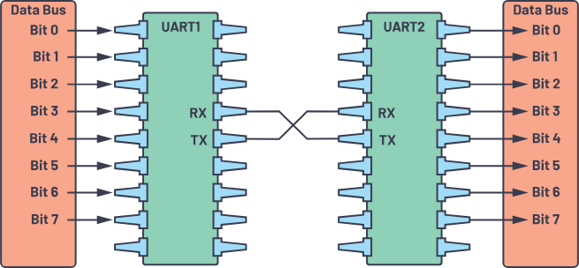
Block Diagram
UART Packet Format
UART with Data Bus

Slide 14
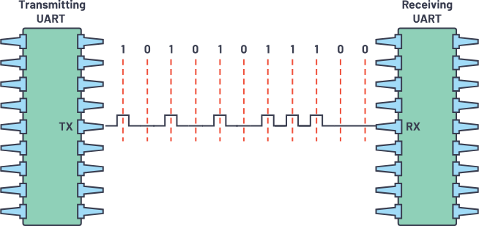
Block Diagram
UART Serial Transmission

Slide 15
Existing Techniques
Verilog/VHDL-Based UARTs:
Implement transmitter, receiver, and baud rate generator.
Limited to functional simulation and manual waveform checking.
SystemVerilog Verification:
Use of Assertions (SVA), Randomized Testing, and Coverage Analysis.
Improves test efficiency but lacks real hardware validation.
FPGA-Based UART Designs:
Multi-UART designs implemented on boards like Nexys 4 DDR.
Verified using Vivado simulation but minimal use of automated verification.
Autoconfigurable UART Controllers:
Automatically adapt baud rate and parity.
High flexibility but no integrated verification environment.

Slide 16
Proposed Methodology
Design Goal: Develop and verify a UART communication protocol supporting reliable serial data exchange between transmitter and receiver modules.
Functional Specification: Define UART frame structure (start, 8 data bits, stop), timing, and baud rate parameterization (CLK_PER_BIT).
RTL Design: Implement synthesizable UART Transmitter and Receiver modules in SystemVerilog ensuring accurate bit timing and data framing.
Verification Environment Setup: Develop a SystemVerilog testbench using class-based methodology with Generator, Driver, Monitor, and Scoreboard components.
Transaction-Level Modeling: Create transaction classes representing UART data packets and randomize stimulus for extensive coverage.
Communication Channel: Use mailbox mechanisms for synchronized data transfer between verification components.
Functional Verification: Check correctness using self-checking testbench — compare transmitted and received data in the scoreboard.
Simulation & Analysis: Run simulations on EDA Playground or ModelSim, analyze waveform and log results to validate UART protocol functionality

Slide 17
Work done for Review-1
module uart (
input logic clk,
input logic rst,
input logic mode, // 1 = transmit, 0 = receive
input logic start, // start signal
input logic rx,
output logic tx
);
parameter int frequency = 50_000_000;
parameter int baud_rate = 115_200;
parameter int data_clk = frequency / baud_rate;
int data_clk_count;
reg go;
reg [10:0] t_buffer;
reg [10:0] r_buffer;
int mem_bit;
int mem_byte;
// Memory to store bytes
reg [7:0] memory[0:7];
always @(posedge clk or negedge rst) begin
if (!rst) begin
go <= 0;
data_clk_count <= 0;
tx <= 1'b1;
mem_bit <= 0;
mem_byte <= 0;
r_buffer <= 11'h0;
t_buffer <= 11'h0;
end
else if (start) begin
if (data_clk_count != data_clk-1) begin
data_clk_count <= data_clk_count+1;
go <= 0;
end else begin
data_clk_count <= 0;
go <= 1;
end
end
end

Slide 18
Work done for Review-1
always @(*) begin
if (go == 1) begin
mem_bit = (mem_bit+1)% 11;
end
if (mem_bit == 10) begin
mem_byte = mem_byte+1;
end
end
always @(*) begin
if (mode) begin
t_buffer = {1'b0, memory[mem_byte], ~^memory[mem_byte], 1'b1};
if (start) begin
tx = t_buffer[mem_bit];
end end
else begin
if (start && rx == 0) begin
r_buffer[mem_bit] = rx;
if (mem_bit ==10) begin
if ((~^r_buffer[8:1]) == r_buffer[9])begin
memory[mem_byte] = r_buffer[8:1];
end end end end
end
endmodule

Slide 19
Work done for Review-1
always @(*) begin
if (go == 1) begin
mem_bit = (mem_bit+1)% 11;
end
if (mem_bit == 10) begin
mem_byte = mem_byte+1;
end
end
always @(*) begin
if (mode) begin
t_buffer = {1'b0, memory[mem_byte], ~^memory[mem_byte], 1'b1};
if (start) begin
tx = t_buffer[mem_bit];
end end
else begin
if (start && rx == 0) begin
r_buffer[mem_bit] = rx;
if (mem_bit ==10) begin
if ((~^r_buffer[8:1]) == r_buffer[9])begin
memory[mem_byte] = r_buffer[8:1];
end end end end
end
endmodule

Slide 20
Work done for Review-1
//UART TRANSMITTER
module uart_tx #(
parameter CLK_FREQ = 50_000_000, // 50 MHz
parameter BAUD_RATE = 9600
)(
input logic clk,
input logic rst_n,
input logic [7:0] tx_data,
input logic tx_start,
output logic tx_serial,
output logic tx_busy
);
localparam integer CLKS_PER_BIT = CLK_FREQ / BAUD_RATE;
typedef enum logic [2:0] {IDLE, START, DATA, STOP} state_t;
state_t state;
logic [15:0] clk_count;
logic [2:0] bit_index;
logic [7:0] tx_shift;
always_ff @(posedge clk or negedge rst_n) begin
if (!rst_n) begin
state <= IDLE;
tx_serial <= 1'b1; // idle high
clk_count <= 0;
bit_index <= 0;
tx_busy <= 0;
end else begin
case (state)
IDLE: begin
tx_serial <= 1'b1;
tx_busy <= 0;
if (tx_start) begin
tx_shift <= tx_data;
state <= START;
tx_busy <= 1;
end
end
START: begin
tx_serial <= 1'b0;
if (clk_count < CLKS_PER_BIT-1)
clk_count <= clk_count + 1;
else begin
clk_count <= 0;
state <= DATA;
end
end
DATA: begin
tx_serial <= tx_shift[bit_index];
if (clk_count < CLKS_PER_BIT-1)
clk_count <= clk_count + 1;
else begin
clk_count <= 0;
if (bit_index < 7)
bit_index <= bit_index + 1;
else begin
bit_index <= 0;
state <= STOP;
end
end
end
STOP: begin
tx_serial <= 1'b1;
if (clk_count < CLKS_PER_BIT-1)
clk_count <= clk_count + 1;
else begin
clk_count <= 0;
state <= IDLE;
tx_busy <= 0;
end
end
endcase
end
end
endmodule

Slide 21
Work done for Review-1
START: begin
if (clk_count == (CLKS_PER_BIT/2)) begin
if (rx_serial == 0) begin
clk_count <= 0;
state <= DATA;
end else
state <= IDLE;
end else
clk_count <= clk_count + 1;
end
DATA: begin
if (clk_count < CLKS_PER_BIT-1)
clk_count <= clk_count + 1;
else begin
clk_count <= 0;
rx_shift[bit_index] <= rx_serial;
if (bit_index < 7)
bit_index <= bit_index + 1;
else begin
bit_index <= 0;
state <= STOP;
end
end
end
STOP: begin
if (clk_count < CLKS_PER_BIT-1)
clk_count <= clk_count + 1;
else begin
clk_count <= 0;
state <= DONE;
end
end
DONE: begin
rx_data <= rx_shift;
rx_valid <= 1;
state <= IDLE;
end
endcase
end
end
endmodule
//UART RECEIVER
module uart_rx #(
parameter CLK_FREQ = 50_000_000,
parameter BAUD_RATE = 9600
)(
input logic clk,
input logic rst_n,
input logic rx_serial,
output logic [7:0] rx_data,
output logic rx_valid
);
localparam integer CLKS_PER_BIT = CLK_FREQ / BAUD_RATE;
typedef enum logic [2:0] {IDLE, START, DATA, STOP, DONE} state_t;
state_t state;
logic [15:0] clk_count;
logic [2:0] bit_index;
logic [7:0] rx_shift;
always_ff @(posedge clk or negedge rst_n) begin
if (!rst_n) begin
state <= IDLE;
clk_count <= 0;
bit_index <= 0;
rx_data <= 0;
rx_valid <= 0;
end else begin
case (state)
IDLE: begin
rx_valid <= 0;
if (rx_serial == 0) begin // start bit
state <= START;
clk_count <= 0;
end
end

Slide 22
Work done for Review-1
initial begin
$dumpfile("uart_wave.vcd");
$dumpvars(0, tb_uart);
clk = 0;
rst_n = 0;
tx_data = 8'h00;
tx_start = 0;
#200 rst_n = 1;
send_byte(8'h55);
send_byte(8'hA5);
send_byte(8'h3C);
#50000;
$display("\nSimulation complete ");
$finish;
end
task send_byte(input [7:0] data);
begin
@(posedge clk);
while (tx_busy) @(posedge clk);
tx_data = data;
tx_start = 1;
@(posedge clk);
tx_start = 0;
$display("[%0t] TX -> Sent Byte = 0x%0h", $time, data);
wait(rx_valid);
$display("[%0t] RX -> Received Byte = 0x%0h", $time, rx_data);
end
endtask
endmodule
//TESTBENCH
module tb_uart;
parameter CLK_PERIOD = 20; // 50 MHz
parameter CLK_FREQ = 50_000_000;
parameter BAUD_RATE = 9600;
logic clk, rst_n;
logic [7:0] tx_data;
logic tx_start;
logic tx_serial;
logic tx_busy;
logic [7:0] rx_data;
logic rx_valid;
// Instantiate TX and RX
uart_tx #(.CLK_FREQ(CLK_FREQ), .BAUD_RATE(BAUD_RATE)) TX (
.clk(clk), .rst_n(rst_n), .tx_data(tx_data),
.tx_start(tx_start), .tx_serial(tx_serial), .tx_busy(tx_busy)
);
uart_rx #(.CLK_FREQ(CLK_FREQ), .BAUD_RATE(BAUD_RATE)) RX (
.clk(clk), .rst_n(rst_n), .rx_serial(tx_serial),
.rx_data(rx_data), .rx_valid(rx_valid)
);
always #(CLK_PERIOD/2) clk = ~clk;

Slide 23
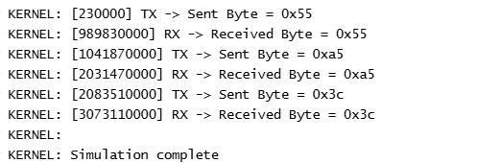
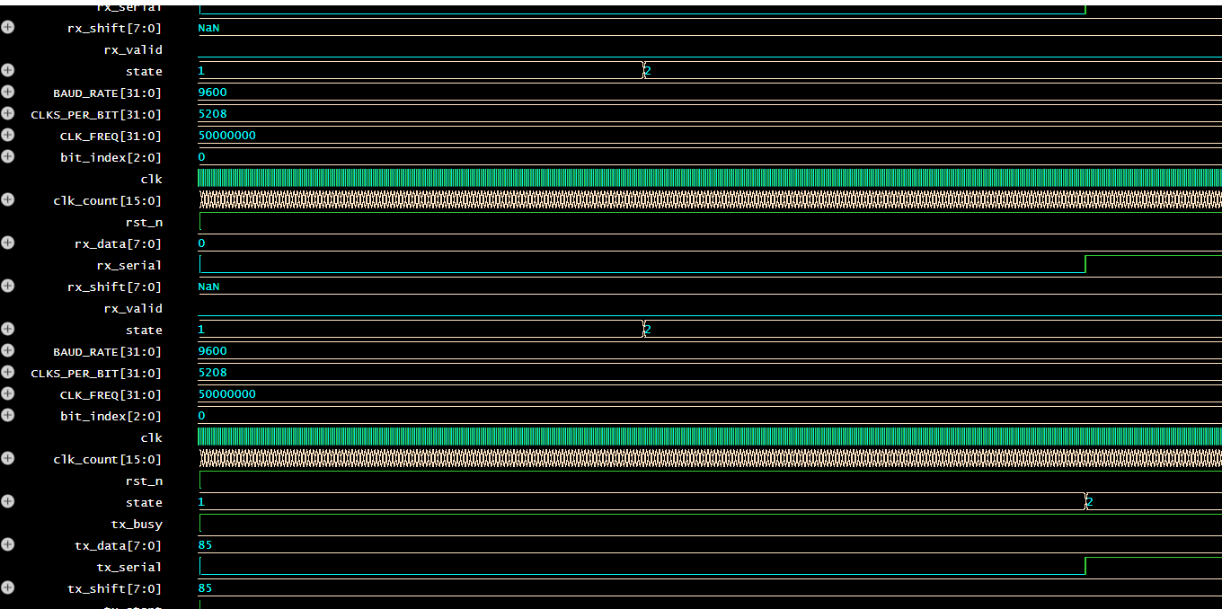
Work done for Review-1

Slide 24
References
1. Wei Ni, Xiaotian Wang, “Functional Coverage-Driven UVM-based UART IP Verification”, IEEE 11th International Conference on ASIC (ASICON), 21 July 2016.
2. Kumari Amrita, Avantika Kumari, “Design And Verification Of Uart Using Verilog Hdl”, International conference on Recent innovations in Management, Engineering, Science and Technology, RIMEST, 2018.
3. Spear, Chris, Tumbush, Greg, “SystemVerilog for Verification” Book.
4. Doron Bustan, Dmitry Korchemny, Erik Seligman, Jin Yang, “SystemVerilog Assertions: Past, Present, and Future SVA Standardization Experience”, IEEE Design & Test of Computers, Volume: 29 , Issue: 2 , April 2012.
5. Renduchinthala H H S S Prasad, Ch. Santhi Rani, ”UART IP Core Verification by using UVM”, International Journal of Industrial Electronics and Electrical Engineering, ISSN: 2347-6982, Volume-4, Issue-7, Jul.-2016
6. Mahat, Nennie Farina. "Design of a 9-bit UART module based on Verilog HDL." Semiconductor Electronics (ICSE), 2012 10th IEEE International Conference on 2012.
7. Ambika, Prof. Anuradha S, “High Speed UART Design Using Verilog”, International Journal of Advanced Research in Computer and Communication Engineering Vol. 5, Issue 2, February 2016.

Slide 25
Conclusion
The UART design is currently in progress and demonstrates the core functionality for serial communication, including basic transmit and receive logic. The initial framework for data framing, parity generation, and timing control has been implemented. Once design completed, it will provide reliable data transfer between digital systems. Overall, the design is progressing well toward a fully functional UART communication module.

Slide 26


